Slide 1

· Powered by
QUEBEC
One Time KYC - Reusable Across Services, Privacy First.
Encrypted Identity vault powered by BlockDAG.
Wallet controlled access. Audit-ready compliance.
Presented by team Quebec

Slide 2
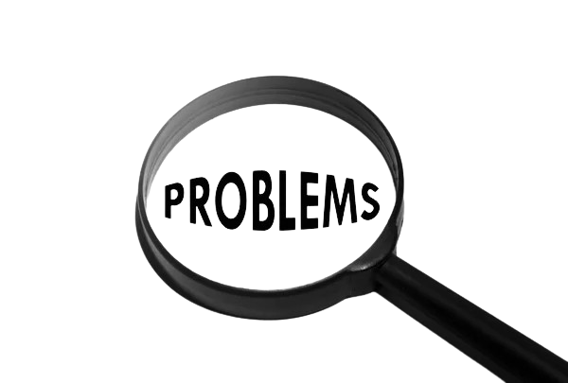
PROBLEM STATEMENT (USER)
Fragmented and Redundant Onboarding
Data Privacy Concerns
Lack of Transparency and Control
Users worry about who can access their sensitive personal data and how it is protected. Without control, their private information may be exposed or misused..
Users cannot easily track or revoke who has access to their identity data. This creates uncertainty and risk around their personal information being shared without consent
Multiple services require repeated
KYC submissions, causing user frustration, higher abandonment rates, and duplicated verification costs.
QUEBEC
BlockDAG

Slide 3

PROBLEM STATEMENT (THIRD-PARTY)
Inefficient Identity Verification
Compliance Complexity
Limited Data Access Control
Third parties spend excess time and resources repeatedly verifying the same user identities. This delays onboarding and increases operational costs.
Meeting regulatory requirements for secure identity handling and audit trails is challenging and costly. Lack of standardized processes increases risk of non-compliance penalties
Third parties struggle to ensure secure, consented access to accurate identity data. This exposes them to fraud risks and weakens trust with users and regulators
QUEBEC
BlockDAG

Slide 4
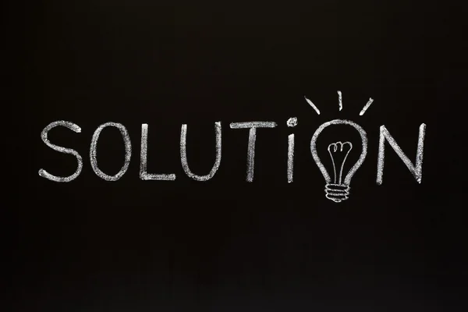
SOLUTION OVERVIEW (USER)
Single KYC for Multiple Services
Full Control Over Personal Data
Transparent Access and Revocation
Quebec allows users to verify their identity once and reuse it securely across different platforms. This reduces onboarding time and eliminates repetitive verifications, improving user convenience
Users encrypt their data locally and control access via wallet-based permissions. This ensures that only authorized parties can see their information, enhancing privacy and trust.
All access and consent actions are recorded immutably on-chain, allowing users to track who views their data. Instant revocation options give users peace of mind and real-time control over their identity.
QUEBEC
BlockDAG

Slide 5
SOLUTION OVERVIEW (THIRD-PARTY)
Streamlined Identity Verification
Built-in Compliance and Auditability
Secure and Consent-Based Data Access
Third parties can verify users through a trusted, reusable on-chain proof without repeating KYC steps. This accelerates onboarding and lowers operational costs.
QUEBEC immutable audit logs and standardized controls support regulatory requirements effortlessly. This reduces compliance complexity and helps avoid penalties
Smart contracts enforce access policies and revocations reliably, minimizing fraud risk. Third parties gain assured, timely consent that builds user and regulator confidence.
QUEBEC
BlockDAG

Slide 6
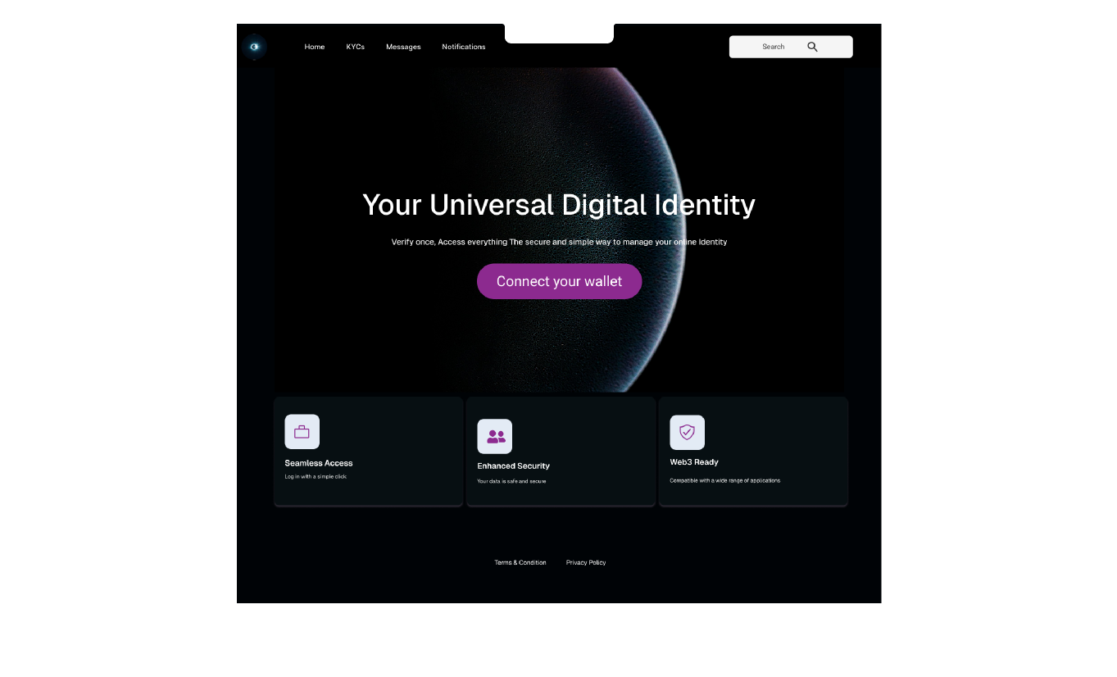
One Time KYC - Reusable Across Services, Privacy first
QUEBEC
Start Your Journey
By connecting
your wallet
Connect your wallet to the BlockDAG network:
Compatible with MetaMask, Trust Wallet, Bitget, and more
Easy setup via WalletConnect or custom RPC
Secure access to BDAG tokens and dApps
https://quebec-1-z9pc.onrender.com/
QUEBEC
BlockDAG

Slide 7
Target Audience
Fintech & Crypto Exchange
Healthcare
Government Services
Banks
Marketplaces & Gig Platforms
etc.
QUEBEC
BlockDAG

Slide 8
Pricing & Revenue
Free
Basic
Premium
$0 / month
$98.9 / month
$1589.9 / month
Enhanced KYC verification
Up to 1000 verifications
Standard
Premuim KYC verification
Unlimited verifications
Priority support
Basic KYC verification
Limited to 50 verifications
QUEBEC
BlockDAG

Slide 9
Payment Methods
Crypto
Fiat
ETH, USDC, USDT, BlockDAG (coming soon)
Card: Visa, Mastercard
via gateway
Bank: SEPA / ACH and
local rails
via:
Metamask or WalletConnect
QUEBEC
BlockDAG

Slide 10




Meet the Team
BABATUNDE JAMIU
(JIHAN JAAMIL)
UI/UX DESIGNER
DESIGN LEAD
MATHIAS OLUWATOYIN
DATA ANALYST AND BETA TESTER
TEAM LEAD
YAKUB SHAKIRUDEEN OLAIDE
FULL-STACK & SMART CONTRACT DEV
LEAD DEVELOPER
SULAIMAN HALIMAT
UI/UX DESIGNER
QUEBEC
BlockDAG

